Slide 1



wateraidcanada.com
Notes:
Good morning/afternoon
Introduction
Set the stage
How much you think about water?
How much you use
Where it comes from?
Is it safe and clean?

Slide 2
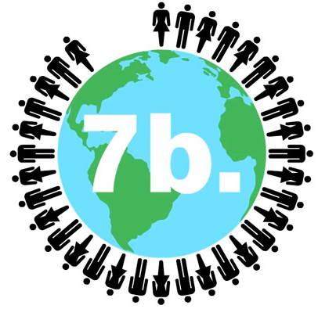
Why is WATER so IMPORTANT
There are more than 7 billion people on the planet and they each need water for:
Sanitation
Food production
Hydration
Quality of Life
PLAY!
Notes:
We can’t survive without it. Water is integral to the production of nearly everything that we use and consume on a daily basis. Water is this amazing unsung hero – yet half the time we don’t even realize it.
Try and make the connection between water and seemingly every aspect of life. Have the kids cite something and you can make the connection.

Slide 3
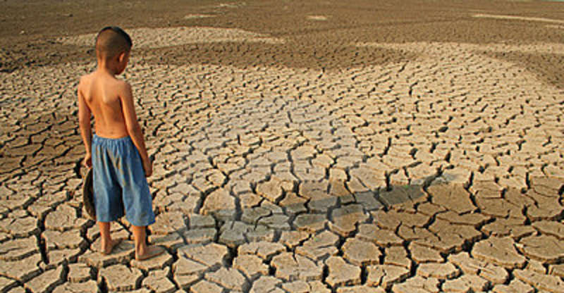
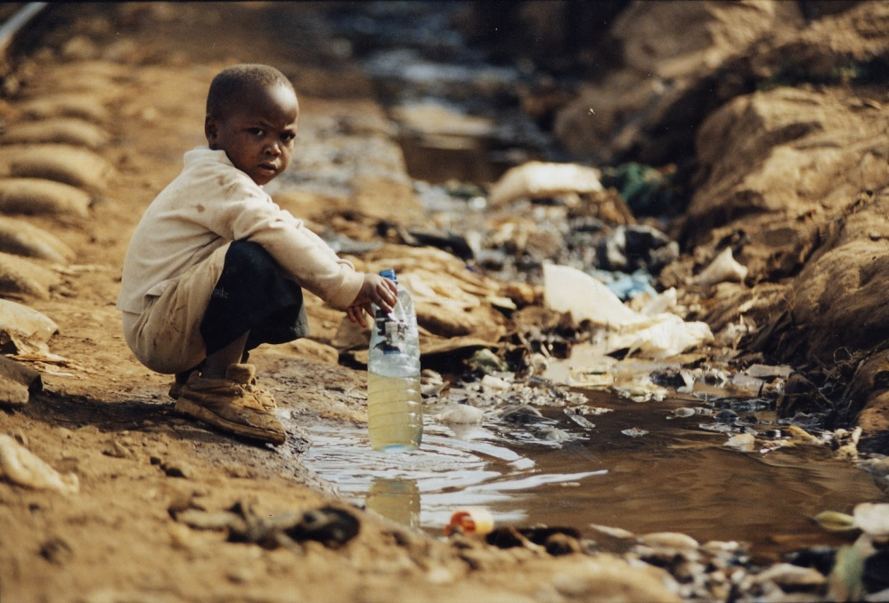
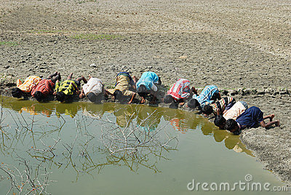
What does it look like when there is not enough?
PLAY!
WASH!
Notes:
It is hard to imagine…isn’t it.
Think about how much water you used this morning, without even thinking about it. In some places that might be more than they can access in a day or week…and what they can is not very clean.
(include this link to Colgate commercial?) https://www.youtube.com/watch?v=CWZJx2sVdWc

Slide 4
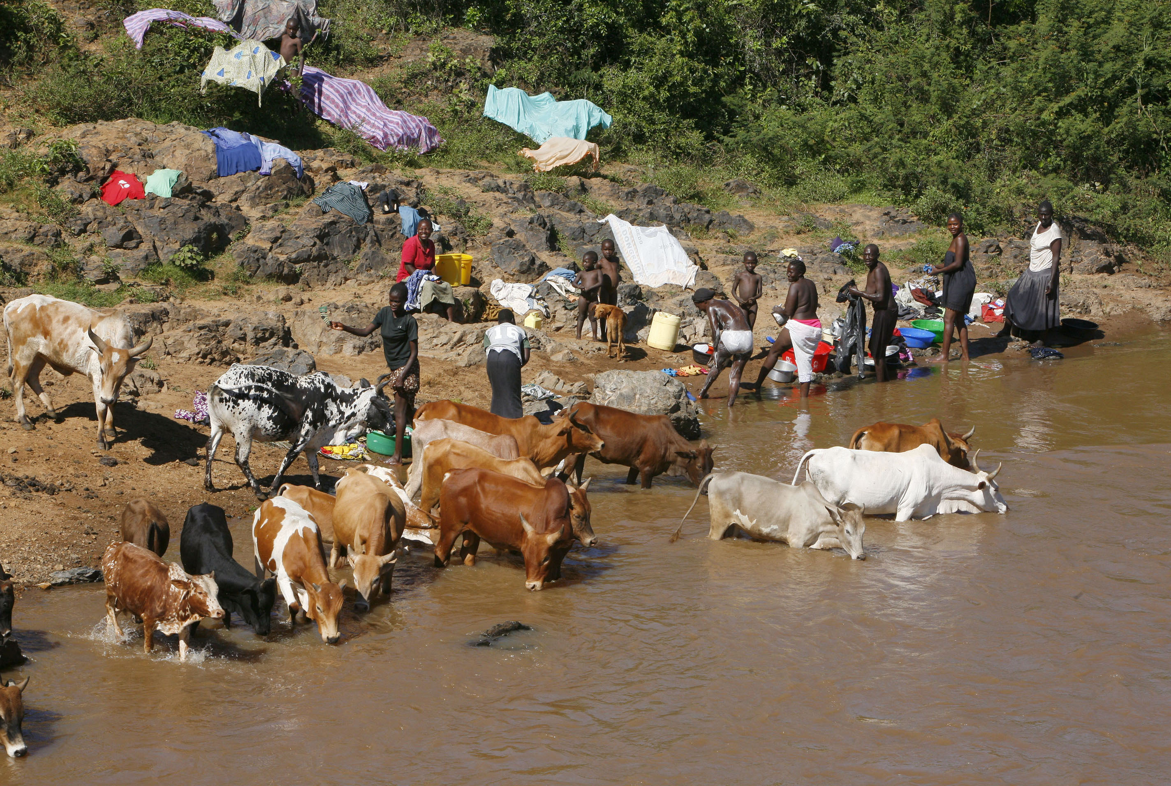
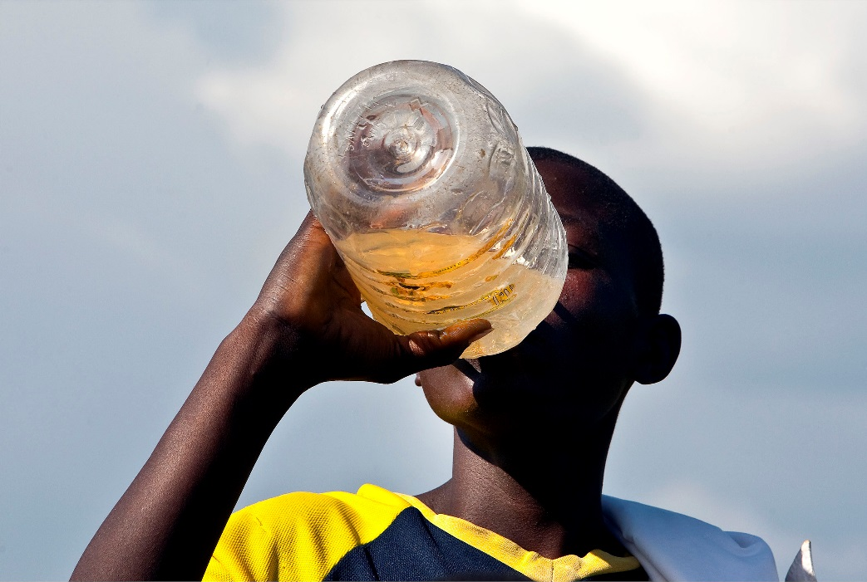
Is There a Water Crisis?
Notes:
You and I have access to clean drinking water day and night at the simple turn of a tap BUT worldwide millions of people aren’t as lucky. They continue to rely on water sources like this – ponds, rivers, lakes, puddles…The same water sources that are used by livestock to drink and cool themselves, children bathe and play and women do laundry and collect water for cooking and drinking.
Can you imagine having to make a choice every day between risking DISEASE and having to be THIRSTY?

Slide 5
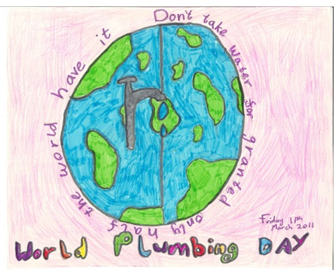
World Plumbing Day
World Plumbing Day happens every year on March 11…all across the world.
Plumbing is critical to leading a happy, healthy life. It is important to recognize that there are parts of the world where they have challenges we don’t even think about here in Canada.
Notes:
This is why I am here today. Talk about your company and what you do. Talk about CIPH and how its members recognize the importance of preserving water for future generations. They are a part of everything including the toilets and faucets you see as well as the pipes underground etc.
To have a conversation that helps you understand how water is in many ways our most important resource. To show you what happens when it is nor around and to talk about how we can all do better in terms of respecting its importance.
We are very lucky here in Canada to have lots of clean water – but lots of other people aren’t so lucky.

Slide 6
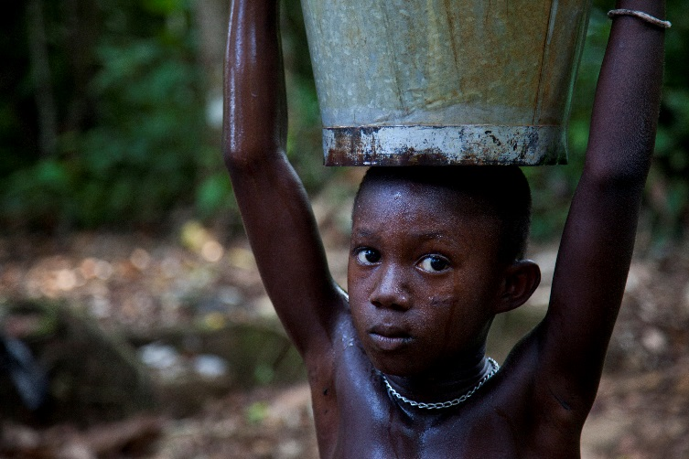
Some Interesting and Scary Numbers
844 million people don’t have clean water.
2.3 billion people don't have a decent toilet.
Every minute a newborn dies from infection caused by lack of safe water and an unclean environment.
Notes:
Although the global water and sanitation crisis doesn’t make media headlines like war and terror, water kills more people through disease each year than war does through guns, more accurately lack of clean water and sanitation – so don’t you think more people should be talking about it.
You know how you hear on the news about terrible earthquakes, hurricanes, tsunamis and the like. Well the fact is that more people die of water and sanitation related diseases each year than all the world’s hurricanes, tsunamis and earthquakes combined.
Unlike those events something can be done to make a real difference.
All of these figures have gown since last year.

Slide 7
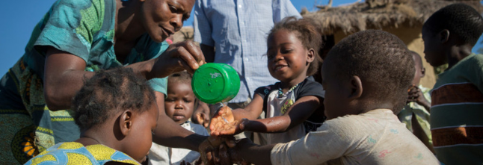
At School (just imagine)
31% of schools don’t have clean water.
Around the world up to 443 million school days are lost every year because of water-related illnesses.

Slide 8
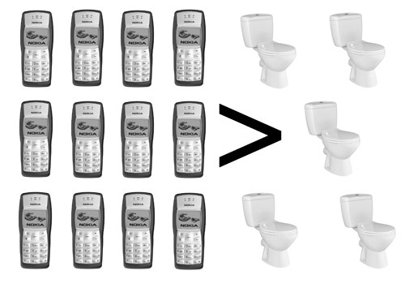
THINK ABOUT
More people have access to a mobile phone than have access to a toilet.

Slide 9
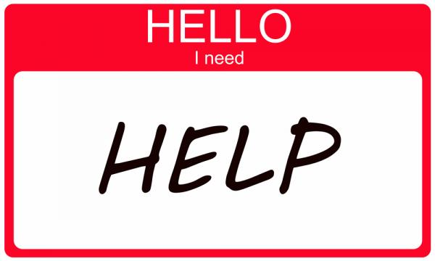
What Can You Do To Help…Lots
Learn and Talk about water with your family like we are doing today
Develop respectful water use habits
Shorter showers
Turn of the tap when brushing your teeth
Consider the sources of what you eat and buy
Notes:
The only good thing about these concerns is that we know what to do and how to help.
Here at home there are lots of things you can do that will show you understand the importance of water in our lives – work with the kids to make a list.
Also there are many organization out there that make a difference in the parts of the world where these issues are of the highest level of concern. Like WaterAid Canada. They offer fundraising and volunteer opportunities.

Slide 10
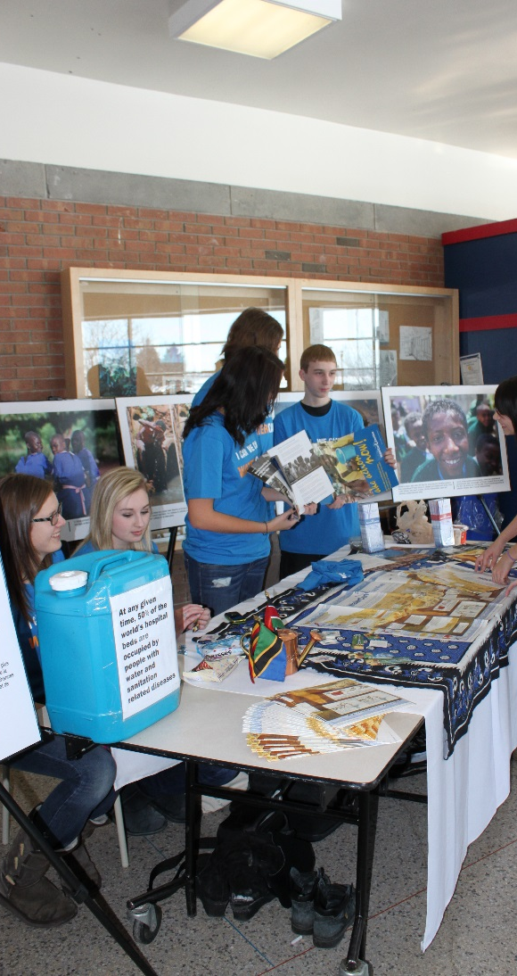
Think about
Learn more about water and sanitation issues Educate others about the issue Advocate for change Donate to help fund projects
Notes:
Making a difference can be as simple as
Learn more about water and sanitation issues:
(I hope) This presentation gave you a lot of information and you learned a lot
Online: www.wateraidcanada.com
Follow WaterAid on Facebook, Twitter, Youtube and Instagram
Educate others about the issue:
Go home and tell your brothers and sisters about what you learned
Share what you learned with friends who might not have seen this presentation
Talk to your parents and ask them what they think about
Advocate for change:
By getting involved, volunteering, writing to your members of parliament
Donate to help fund projects
Participate in WaterAid Canada’s School by School challenge, help bring clean water and basic sanitation to kids your age!

Slide 11

Notes:
It should finish with a statement about World Plumbing Day….
The thing about the global water and sanitation crisis is that it doesn’t require high tech solutions or new discoveries.
It is entirely possible for us to ensure that everybody, everywhere on earth has access to clean water. There is enough water to go around, more than enough money in the world, more than enough knowledge, what we need is more than enough people deciding that this is something that they care about!

Slide 12



/wateraidcanada
/wateraidcanada

